Slide 1
A Fractional Sequence
Source: http://nrich.maths.org/475
Loopy

Slide 2
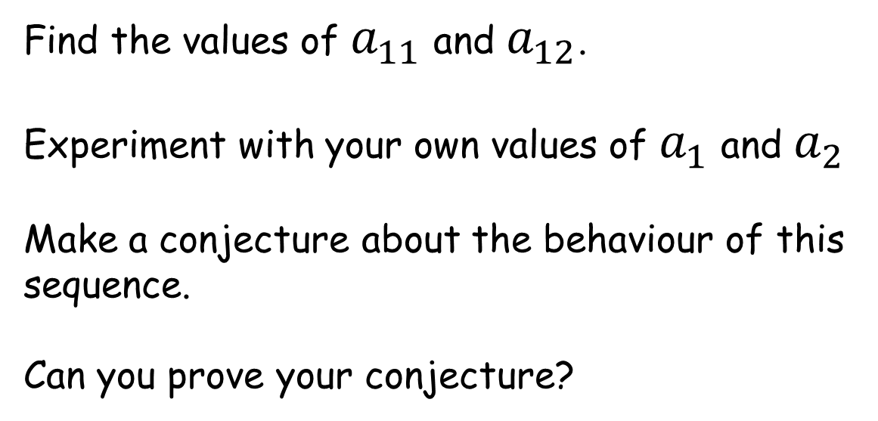
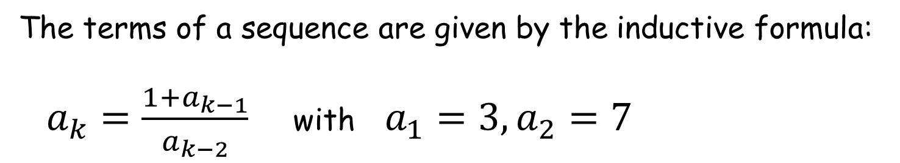
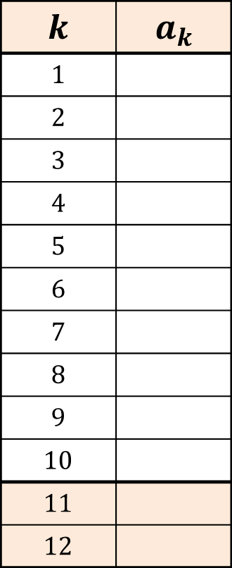
A Fractional Sequence
The terms of a sequence are given by the inductive formula:
$a_{k}=\frac{1+a_{k−1}}{a_{k−2}}$ with $a_{1}=3, a_{2}=7$
$$k$$ | $$a_{k}$$
$$1$$
$$2$$
$$3$$
$$4$$
$$5$$
$$6$$
$$7$$
$$8$$
$$9$$
$$10$$
$$11$$
$$12$$
Find the values of $a_{11}$ and $a_{12}$.
Experiment with your own values of $a_{1}$ and $a_{2}$
Make a conjecture about the behaviour of this sequence.
Can you prove your conjecture?

Slide 3
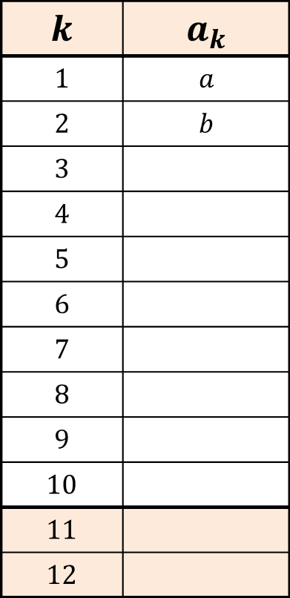
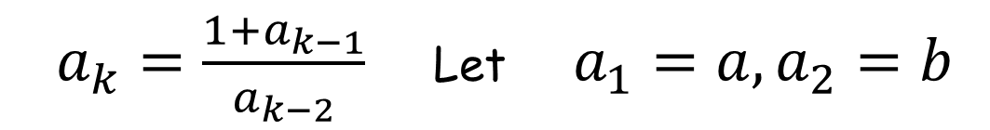
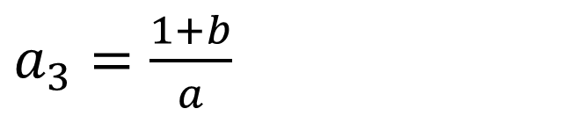
A Fractional Sequence
$$k$$ | $$a_{k}$$
$$1$$ | $$a$$
$$2$$ | $$b$$
$$3$$
$$4$$
$$5$$
$$6$$
$$7$$
$$8$$
$$9$$
$$10$$
$$11$$
$$12$$
$a_{k}=\frac{1+a_{k−1}}{a_{k−2}}$ Let $a_{1}=a, a_{2}=b$
$a_{3}=\frac{1+b}{a}$

Slide 4
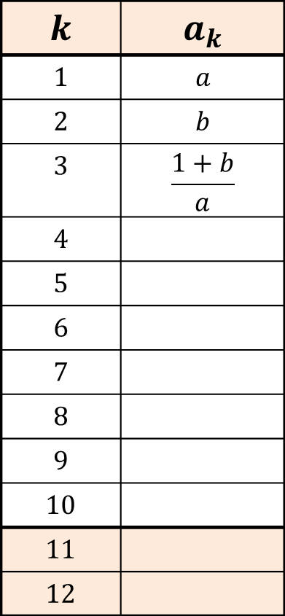
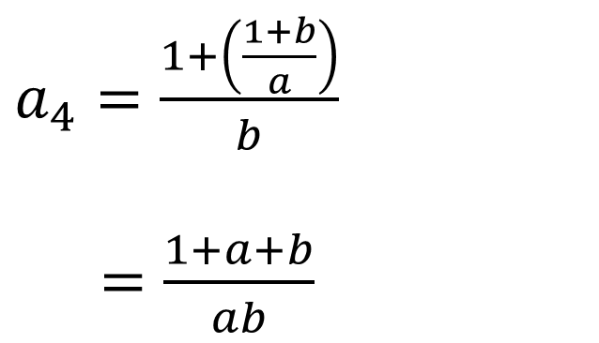
A Fractional Sequence
$$k$$ | $$a_{k}$$
$$1$$ | $$a$$
$$2$$ | $$b$$
$$3$$ | $$\frac{1+b}{a}$$
$$4$$
$$5$$
$$6$$
$$7$$
$$8$$
$$9$$
$$10$$
$$11$$
$$12$$
$a_{k}=\frac{1+a_{k−1}}{a_{k−2}}$ Let $a_{1}=a, a_{2}=b$
$a_{4}=\frac{1+\left(\frac{1+b}{a}\right)}{b}$
$=\frac{1+a+b}{ab}$

Slide 5
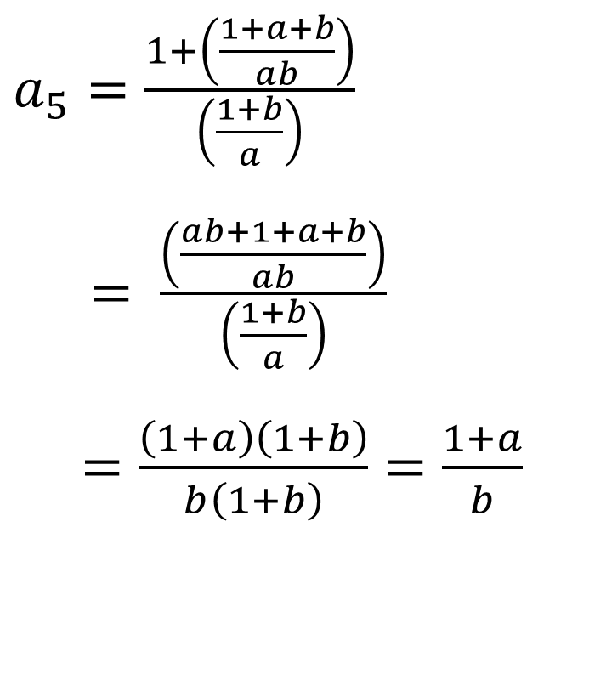
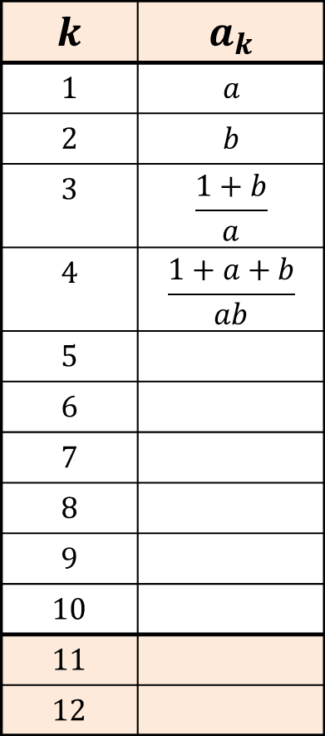
A Fractional Sequence
$$k$$ | $$a_{k}$$
$$1$$ | $$a$$
$$2$$ | $$b$$
$$3$$ | $$\frac{1+b}{a}$$
$$4$$ | $$\frac{1+a+b}{ab}$$
$$5$$
$$6$$
$$7$$
$$8$$
$$9$$
$$10$$
$$11$$
$$12$$
$a_{k}=\frac{1+a_{k−1}}{a_{k−2}}$ Let $a_{1}=a, a_{2}=b$
$a_{5}=\frac{1+\left(\frac{1+a+b}{ab}\right)}{\left(\frac{1+b}{a}\right)}$
$= \frac{\left(\frac{ab+1+a+b}{ab}\right)}{\left(\frac{1+b}{a}\right)}$
$=\frac{\left(1+a\right)\left(1+b\right)}{b\left(1+b\right)}=\frac{1+a}{b}$

Slide 6

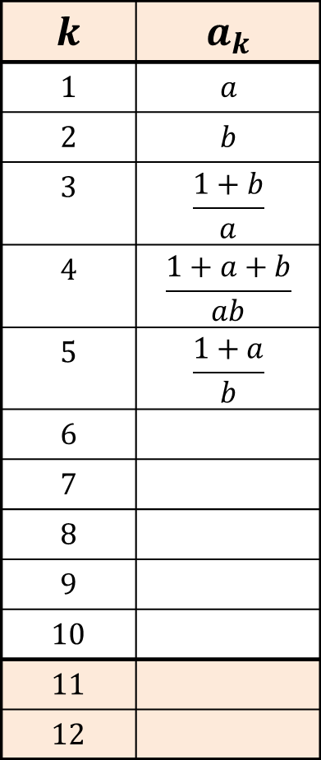
A Fractional Sequence
$$k$$ | $$a_{k}$$
$$1$$ | $$a$$
$$2$$ | $$b$$
$$3$$ | $$\frac{1+b}{a}$$
$$4$$ | $$\frac{1+a+b}{ab}$$
$$5$$ | $$\frac{1+a}{b}$$
$$6$$
$$7$$
$$8$$
$$9$$
$$10$$
$$11$$
$$12$$
$a_{k}=\frac{1+a_{k−1}}{a_{k−2}}$ Let $a_{1}=a, a_{2}=b$
$a_{6}=\frac{1+\left(\frac{1+a}{b}\right)}{\left(\frac{1+a+b}{ab}\right)}$
$= \frac{\left(\frac{1+a+b}{b}\right)}{\left(\frac{1+a+b}{ab}\right)}$
$=a$

Slide 7


A Fractional Sequence
$$k$$ | $$a_{k}$$
$$1$$ | $$a$$
$$2$$ | $$b$$
$$3$$ | $$\frac{1+b}{a}$$
$$4$$ | $$\frac{1+a+b}{ab}$$
$$5$$ | $$\frac{1+a}{b}$$
$$6$$ | $$a$$
$$7$$
$$8$$
$$9$$
$$10$$
$$11$$
$$12$$
$a_{k}=\frac{1+a_{k−1}}{a_{k−2}}$ Let $a_{1}=a, a_{2}=b$
$a_{7}=\frac{1+a}{\left(\frac{1+a}{b}\right)}$
$=b$

Slide 8

A Fractional Sequence
$$k$$ | $$a_{k}$$
$$1$$ | $$a$$
$$2$$ | $$b$$
$$3$$ | $$\frac{1+b}{a}$$
$$4$$ | $$\frac{1+a+b}{ab}$$
$$5$$ | $$\frac{1+a}{b}$$
$$6$$ | $$a$$
$$7$$ | $$b$$
$$8$$
$$9$$
$$10$$
$$11$$
$$12$$
$a_{k}=\frac{1+a_{k−1}}{a_{k−2}}$ Let $a_{1}=a, a_{2}=b$
The sequence loops and so we can go straight to the 11th and 12th terms.

Slide 9
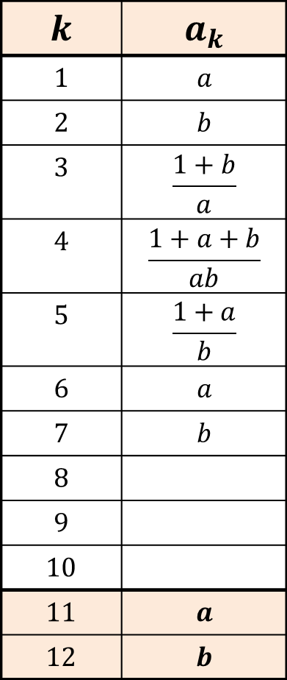
A Fractional Sequence
$$k$$ | $$a_{k}$$
$$1$$ | $$a$$
$$2$$ | $$b$$
$$3$$ | $$\frac{1+b}{a}$$
$$4$$ | $$\frac{1+a+b}{ab}$$
$$5$$ | $$\frac{1+a}{b}$$
$$6$$ | $$a$$
$$7$$ | $$b$$
$$8$$
$$9$$
$$10$$
$$11$$ | $$a$$
$$12$$ | $$b$$
$a_{k}=\frac{1+a_{k−1}}{a_{k−2}}$ Let $a_{1}=a, a_{2}=b$
The sequence loops and so we can go straight to the 11th and 12th terms.

Slide 11
RESOURCES

Slide 12
A Fractional Sequence
The terms of a sequence are given by the inductive formula:
$a_{k}=\frac{1+a_{k−1}}{a_{k−2}}$ with $a_{1}=3, a_{2}=7$
$$k$$ | $$a_{k}$$
$$1$$
$$2$$
$$3$$
$$4$$
$$5$$
$$6$$
$$7$$
$$8$$
$$9$$
$$10$$
$$11$$
$$12$$
Find the values of $a_{11}$ and $a_{12}$.
Experiment with your own values of $a_{1}$ and $a_{2}$
Make a conjecture about the behaviour of this sequence.
Can you prove your conjecture?
SIC_23

Slide 13
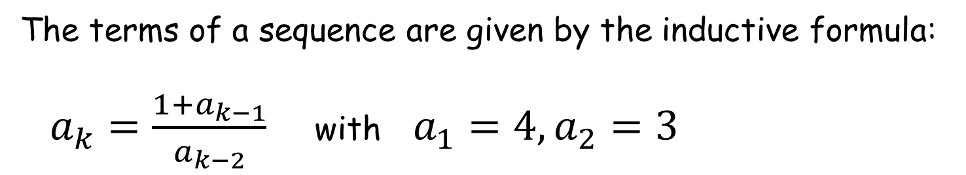
A Fractional Sequence
The terms of a sequence are given by the inductive formula:
$a_{k}=\frac{1+a_{k−1}}{a_{k−2}}$ with $a_{1}=4, a_{2}=3$
$$k$$ | $$a_{k}$$
$$1$$
$$2$$
$$3$$
$$4$$
$$5$$
$$6$$
$$7$$
$$8$$
$$9$$
$$10$$
$$11$$
$$12$$
Find the values of $a_{11}$ and $a_{12}$.
Experiment with your own values of $a_{1}$ and $a_{2}$
Make a conjecture about the behaviour of this sequence.
Can you prove your conjecture?
SIC_23

Slide 14
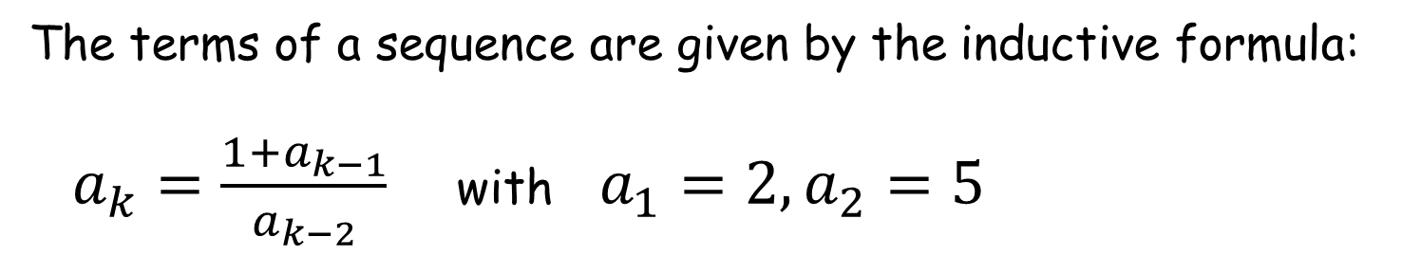
A Fractional Sequence
The terms of a sequence are given by the inductive formula:
$a_{k}=\frac{1+a_{k−1}}{a_{k−2}}$ with $a_{1}=2, a_{2}=5$
$$k$$ | $$a_{k}$$
$$1$$
$$2$$
$$3$$
$$4$$
$$5$$
$$6$$
$$7$$
$$8$$
$$9$$
$$10$$
$$11$$
$$12$$
Find the values of $a_{11}$ and $a_{12}$.
Experiment with your own values of $a_{1}$ and $a_{2}$
Make a conjecture about the behaviour of this sequence.
Can you prove your conjecture?
SIC_23

Slide 15
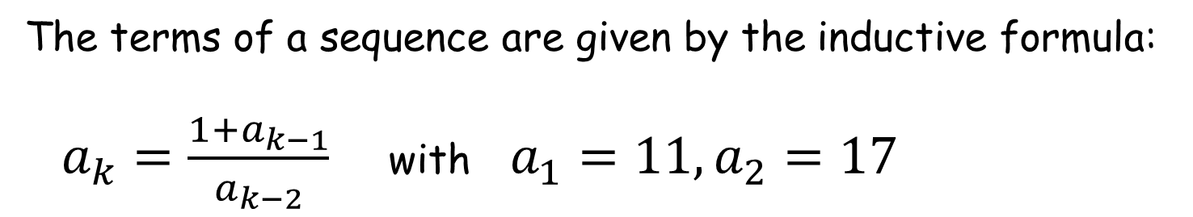
A Fractional Sequence
The terms of a sequence are given by the inductive formula:
$a_{k}=\frac{1+a_{k−1}}{a_{k−2}}$ with $a_{1}=11, a_{2}=17$
$$k$$ | $$a_{k}$$
$$1$$
$$2$$
$$3$$
$$4$$
$$5$$
$$6$$
$$7$$
$$8$$
$$9$$
$$10$$
$$11$$
$$12$$
Find the values of $a_{11}$ and $a_{12}$.
Experiment with your own values of $a_{1}$ and $a_{2}$
Make a conjecture about the behaviour of this sequence.
Can you prove your conjecture?
SIC_23

Slide 16
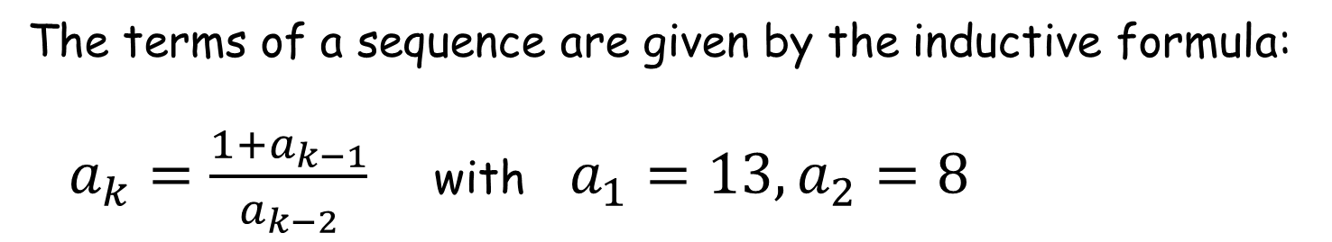
A Fractional Sequence
The terms of a sequence are given by the inductive formula:
$a_{k}=\frac{1+a_{k−1}}{a_{k−2}}$ with $a_{1}=13, a_{2}=8$
$$k$$ | $$a_{k}$$
$$1$$
$$2$$
$$3$$
$$4$$
$$5$$
$$6$$
$$7$$
$$8$$
$$9$$
$$10$$
$$11$$
$$12$$
Find the values of $a_{11}$ and $a_{12}$.
Experiment with your own values of $a_{1}$ and $a_{2}$
Make a conjecture about the behaviour of this sequence.
Can you prove your conjecture?
SIC_23

Slide 17
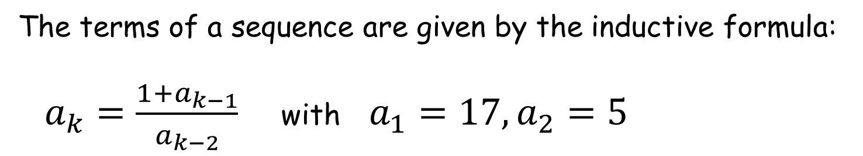
A Fractional Sequence
The terms of a sequence are given by the inductive formula:
$a_{k}=\frac{1+a_{k−1}}{a_{k−2}}$ with $a_{1}=17, a_{2}=5$
$$k$$ | $$a_{k}$$
$$1$$
$$2$$
$$3$$
$$4$$
$$5$$
$$6$$
$$7$$
$$8$$
$$9$$
$$10$$
$$11$$
$$12$$
Find the values of $a_{11}$ and $a_{12}$.
Experiment with your own values of $a_{1}$ and $a_{2}$
Make a conjecture about the behaviour of this sequence.
Can you prove your conjecture?
SIC_23

Slide 18
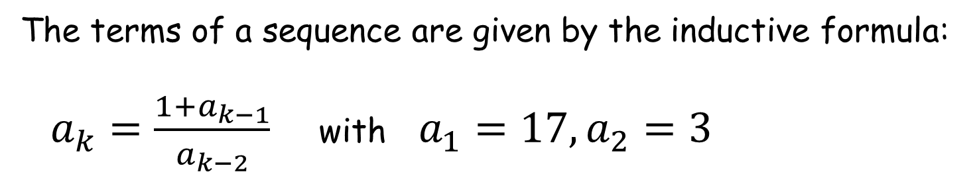
A Fractional Sequence
The terms of a sequence are given by the inductive formula:
$a_{k}=\frac{1+a_{k−1}}{a_{k−2}}$ with $a_{1}=17, a_{2}=3$
$$k$$ | $$a_{k}$$
$$1$$
$$2$$
$$3$$
$$4$$
$$5$$
$$6$$
$$7$$
$$8$$
$$9$$
$$10$$
$$11$$
$$12$$
Find the values of $a_{11}$ and $a_{12}$.
Experiment with your own values of $a_{1}$ and $a_{2}$
Make a conjecture about the behaviour of this sequence.
Can you prove your conjecture?
SIC_23

Slide 19
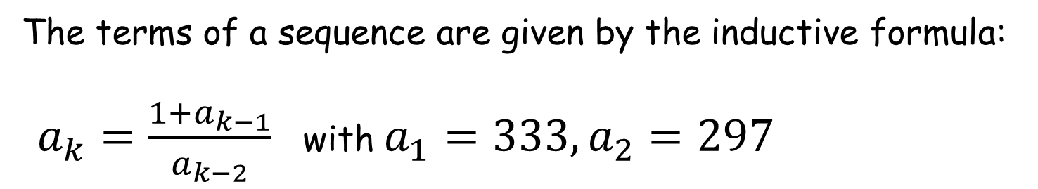
A Fractional Sequence
The terms of a sequence are given by the inductive formula:
$a_{k}=\frac{1+a_{k−1}}{a_{k−2}}$ with $a_{1}=333, a_{2}=297$
$$k$$ | $$a_{k}$$
$$1$$
$$2$$
$$3$$
$$4$$
$$5$$
$$6$$
$$7$$
$$8$$
$$9$$
$$10$$
$$11$$
$$12$$
Find the values of $a_{11}$ and $a_{12}$.
Experiment with your own values of $a_{1}$ and $a_{2}$
Make a conjecture about the behaviour of this sequence.
Can you prove your conjecture?
SIC_23

Slide 20
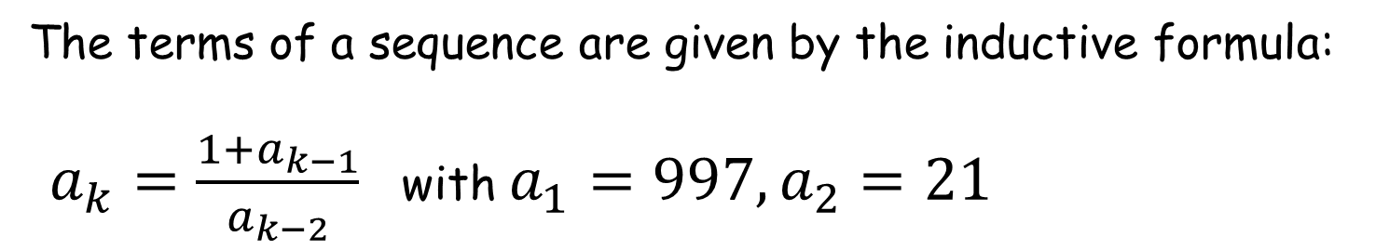
A Fractional Sequence
The terms of a sequence are given by the inductive formula:
$a_{k}=\frac{1+a_{k−1}}{a_{k−2}}$ with $a_{1}=997, a_{2}=21$
$$k$$ | $$a_{k}$$
$$1$$
$$2$$
$$3$$
$$4$$
$$5$$
$$6$$
$$7$$
$$8$$
$$9$$
$$10$$
$$11$$
$$12$$
Find the values of $a_{11}$ and $a_{12}$.
Experiment with your own values of $a_{1}$ and $a_{2}$
Make a conjecture about the behaviour of this sequence.
Can you prove your conjecture?
SIC_23

Slide 21
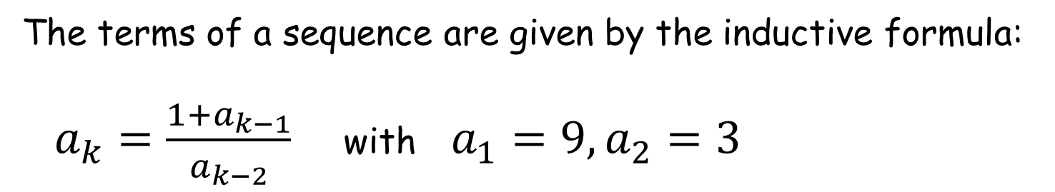
A Fractional Sequence
The terms of a sequence are given by the inductive formula:
$a_{k}=\frac{1+a_{k−1}}{a_{k−2}}$ with $a_{1}=9, a_{2}=3$
$$k$$ | $$a_{k}$$
$$1$$
$$2$$
$$3$$
$$4$$
$$5$$
$$6$$
$$7$$
$$8$$
$$9$$
$$10$$
$$11$$
$$12$$
Find the values of $a_{11}$ and $a_{12}$.
Experiment with your own values of $a_{1}$ and $a_{2}$
Make a conjecture about the behaviour of this sequence.
Can you prove your conjecture?
SIC_23

Slide 22
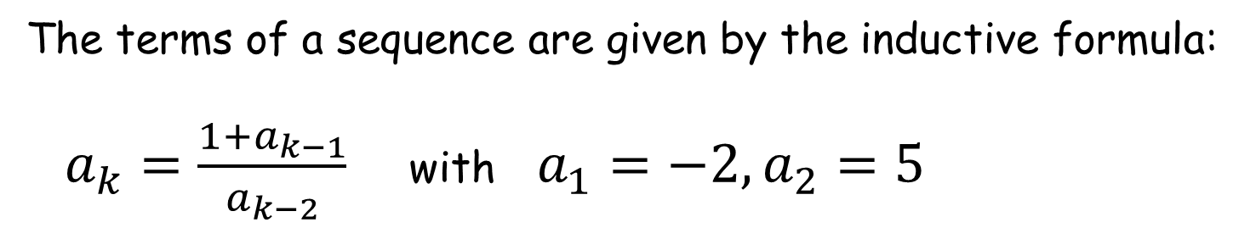
A Fractional Sequence
The terms of a sequence are given by the inductive formula:
$a_{k}=\frac{1+a_{k−1}}{a_{k−2}}$ with $a_{1}=−2, a_{2}=5$
$$k$$ | $$a_{k}$$
$$1$$
$$2$$
$$3$$
$$4$$
$$5$$
$$6$$
$$7$$
$$8$$
$$9$$
$$10$$
$$11$$
$$12$$
Find the values of $a_{11}$ and $a_{12}$.
Experiment with your own values of $a_{1}$ and $a_{2}$
Make a conjecture about the behaviour of this sequence.
Can you prove your conjecture?
SIC_23

Slide 23
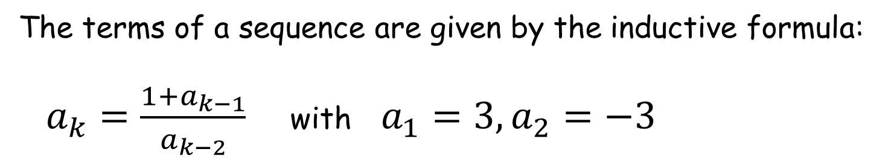
A Fractional Sequence
The terms of a sequence are given by the inductive formula:
$a_{k}=\frac{1+a_{k−1}}{a_{k−2}}$ with $a_{1}=3, a_{2}=−3$
$$k$$ | $$a_{k}$$
$$1$$
$$2$$
$$3$$
$$4$$
$$5$$
$$6$$
$$7$$
$$8$$
$$9$$
$$10$$
$$11$$
$$12$$
Find the values of $a_{11}$ and $a_{12}$.
Experiment with your own values of $a_{1}$ and $a_{2}$
Make a conjecture about the behaviour of this sequence.
Can you prove your conjecture?
SIC_23

Slide 24
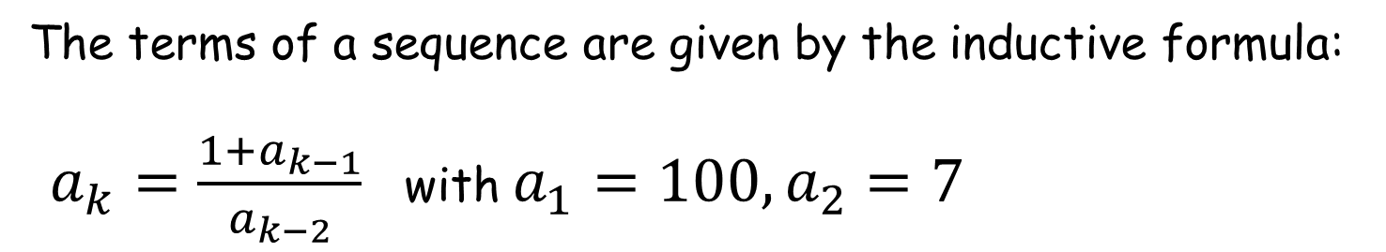
A Fractional Sequence
The terms of a sequence are given by the inductive formula:
$a_{k}=\frac{1+a_{k−1}}{a_{k−2}}$ with $a_{1}=100, a_{2}=7$
$$k$$ | $$a_{k}$$
$$1$$
$$2$$
$$3$$
$$4$$
$$5$$
$$6$$
$$7$$
$$8$$
$$9$$
$$10$$
$$11$$
$$12$$
Find the values of $a_{11}$ and $a_{12}$.
Experiment with your own values of $a_{1}$ and $a_{2}$
Make a conjecture about the behaviour of this sequence.
Can you prove your conjecture?
SIC_23

Slide 25
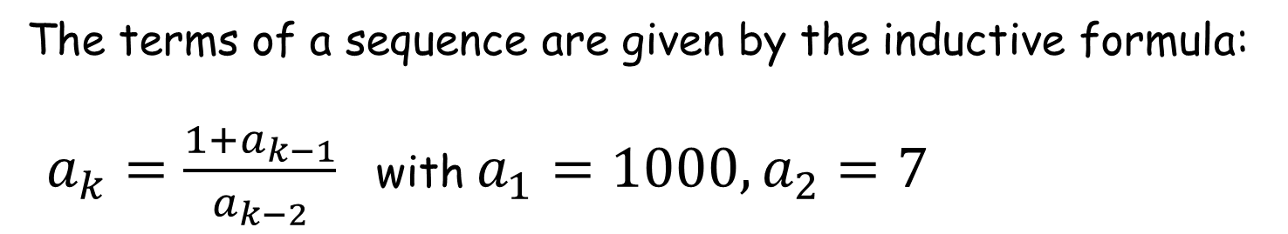
A Fractional Sequence
The terms of a sequence are given by the inductive formula:
$a_{k}=\frac{1+a_{k−1}}{a_{k−2}}$ with $a_{1}=1000, a_{2}=7$
$$k$$ | $$a_{k}$$
$$1$$
$$2$$
$$3$$
$$4$$
$$5$$
$$6$$
$$7$$
$$8$$
$$9$$
$$10$$
$$11$$
$$12$$
Find the values of $a_{11}$ and $a_{12}$.
Experiment with your own values of $a_{1}$ and $a_{2}$
Make a conjecture about the behaviour of this sequence.
Can you prove your conjecture?
SIC_23

Slide 26
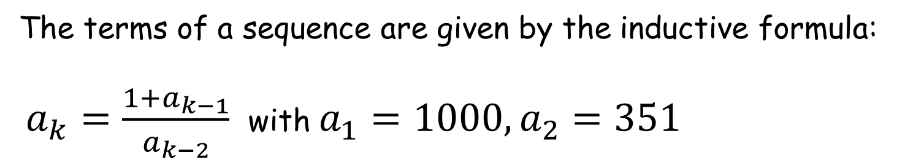
A Fractional Sequence
The terms of a sequence are given by the inductive formula:
$a_{k}=\frac{1+a_{k−1}}{a_{k−2}}$ with $a_{1}=1000, a_{2}=351$
$$k$$ | $$a_{k}$$
$$1$$
$$2$$
$$3$$
$$4$$
$$5$$
$$6$$
$$7$$
$$8$$
$$9$$
$$10$$
$$11$$
$$12$$
Find the values of $a_{11}$ and $a_{12}$.
Experiment with your own values of $a_{1}$ and $a_{2}$
Make a conjecture about the behaviour of this sequence.
Can you prove your conjecture?
SIC_23

Slide 27
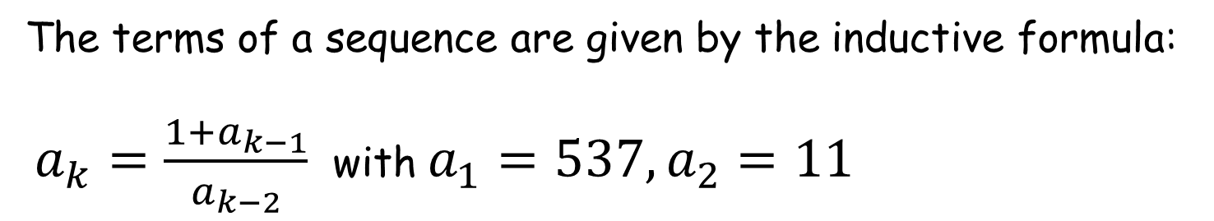
A Fractional Sequence
The terms of a sequence are given by the inductive formula:
$a_{k}=\frac{1+a_{k−1}}{a_{k−2}}$ with $a_{1}=537, a_{2}=11$
$$k$$ | $$a_{k}$$
$$1$$
$$2$$
$$3$$
$$4$$
$$5$$
$$6$$
$$7$$
$$8$$
$$9$$
$$10$$
$$11$$
$$12$$
Find the values of $a_{11}$ and $a_{12}$.
Experiment with your own values of $a_{1}$ and $a_{2}$
Make a conjecture about the behaviour of this sequence.
Can you prove your conjecture?
SIC_23

